Slide 1
Machine Learning DASC 522
Feature Selection of the English Language
Using
Natural Language Processing
Dr. Torrey Wagner

Slide 2
Overview
Big Picture & Introduction
Tokenization
Count Vectorization
Python Demonstration

Slide 3
Overview
Big Picture & Introduction
Tokenization
Count Vectorization
Python Demonstration
https://gdcoder.com/nlp-transforming-tokens-into-features-tf-idf/

Slide 4
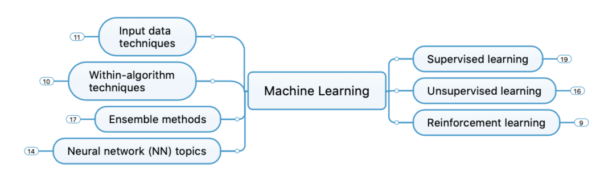
Big Picture - Concept Map

Slide 5
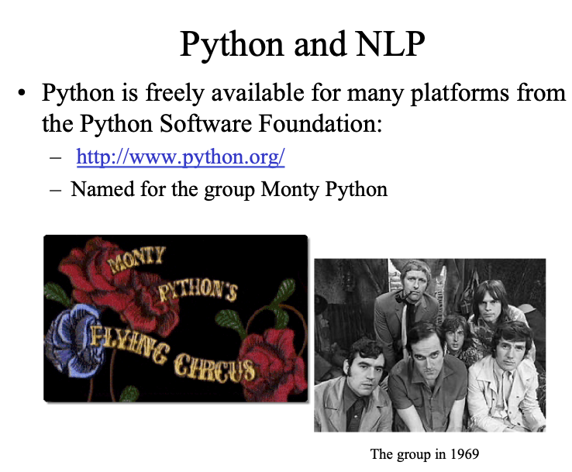
Background
Slide from http://classes.ischool.syr.edu/ist664/NLPFall2011/NLTKintro.2011.ppt.pdf

Slide 6
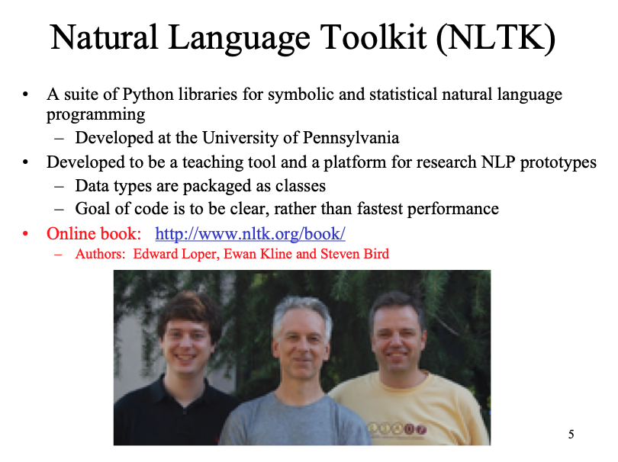
Background
Slide from http://classes.ischool.syr.edu/ist664/NLPFall2011/NLTKintro.2011.ppt.pdf

Slide 7
Natural Language Processing (NLP)‏
How can we make a computer understand language?
Can a human write/talk to the computer?
Or can the computer guess/predict the input?
Can the computer talk back?
Based on language rules, patterns, or statistics
For now, statistics are more accurate and popular
Slide from CSE 142 Python Slides - Washingtonhttps://courses.cs.washington.edu › python › week7at link

Slide 8
Some areas of NLP
shallow processing – the surface level
tokenization
word counts (count vectorization)
part-of-speech tagging
forms of words
deep processing – the underlying structures of language
word order (syntax)‏
meaning
translation
natural language generation
Slide from CSE 142 Python Slides - Washingtonhttps://courses.cs.washington.edu › python › week7at link

Slide 9
Overview
Big Picture & Introduction
Tokenization
Count Vectorization
Python Demonstration

Slide 10
Tokenization
Say we want to know the words in Marty's vocabulary
"You know what I hate? Anybody who drives an S.U.V. I'd really like to find Mr. It-Costs-Me-100-Dollars-To-Gas-Up and bless him square in the feelings. Booyah. Be like, I'm Marty Stepp, the best ever. Booyah!"
How do we split his speech into tokens?
Slide from CSE 142 Python Slides - Washingtonhttps://courses.cs.washington.edu › python › week7at link

Slide 11
Tokenization (cont.)‏
How do we split his speech into tokens?
>>> martysSpeech.split()‏
['You', 'know', 'what', 'I', 'hate?', 'Anybody', 'who', 'drives', 'an', 'S.U.V.', "I'd", 'really', 'like', 'to', 'find', 'Mr.', 'It-Costs-Me-100-Dollars-To-Gas-Up', 'and', ‘bless', 'him', 'square', 'in', 'the', ‘feelings.', 'Booyah.', 'Be', 'like,', "I'm", 'Marty', 'Stepp,', 'the', 'best', 'ever.', 'Booyah!']
Now, how often does he use the word "booyah"?
>>> martysSpeech.split().count("booyah")‏
0
Slide from CSE 142 Python Slides - Washingtonhttps://courses.cs.washington.edu › python › week7at link

Slide 12
Tokenization (cont.)‏
We could lowercase the speech
We could write our own method to split on "." split on ",", split on "-", etc.
The NLTK already has several tokenizer options
Try:
nltk.tokenize.WordPunktTokenizer
tokenizes on all punctuation
nltk.tokenize.PunktWordTokenizer
trained algorithm to statistically split on words
Slide from CSE 142 Python Slides - Washingtonhttps://courses.cs.washington.edu › python › week7at link

Slide 13
Overview
Big Picture & Introduction
Tokenization
Count Vectorization
Python Demonstration

Slide 14
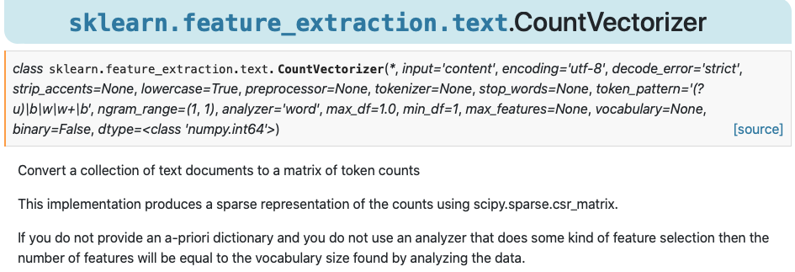
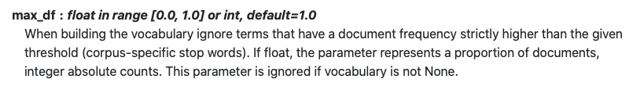
Count Vectorizer
https://scikit-learn.org/stable/modules/generated/sklearn.feature_extraction.text.CountVectorizer.html
https://gdcoder.com/nlp-transforming-tokens-into-features-tf-idf/

Slide 15
Overview
Big Picture & Introduction
Tokenization
Count Vectorization
Python Demonstration

Slide 16
Part-of-speech (POS) tagging
If you know a token's POS you know:
is it the subject?
is it the verb?
is it introducing a grammatical structure?
is it a proper name?
Slide from CSE 142 Python Slides - Washingtonhttps://courses.cs.washington.edu › python › week7at link

Slide 17
POS tagging (cont.)‏
How do we tag plain sentences?
A NLTK tagger needs a list of tagged sentences to train on
We'll use nltk.corpus.treebank.tagged_sents()‏
Then it is ready to tag any input! (but how well?)‏
Try these tagger objects:
nltk.UnigramTagger(tagged_sentences)‏
nltk.TrigramTagger(tagged_sentences)‏
Call the tagger's tag(tokens) method
>>> tagger = nltk.UnigramTagger(tagged_sentences)‏
>>> result = tagger.tag(tokens)‏
>>> result
[('You', 'PRP'), ('know', 'VB'), ('what', 'WP'), ('I', 'PRP'), ('hate', None), ('?', '.'), ...]
Slide from CSE 142 Python Slides - Washingtonhttps://courses.cs.washington.edu › python › week7at link

Slide 18
Overview
Big Picture & Introduction
Tokenization
Count Vectorization
Python Demonstration

